Slide 1


Slide 2

Customer Engagement
When we love each other, we love our customer

Slide 3
What’s Happening this Month?
♡ Encourage One Another
♡ Lunch and Learn
♡ Quizzes
♡ Contests

Slide 4
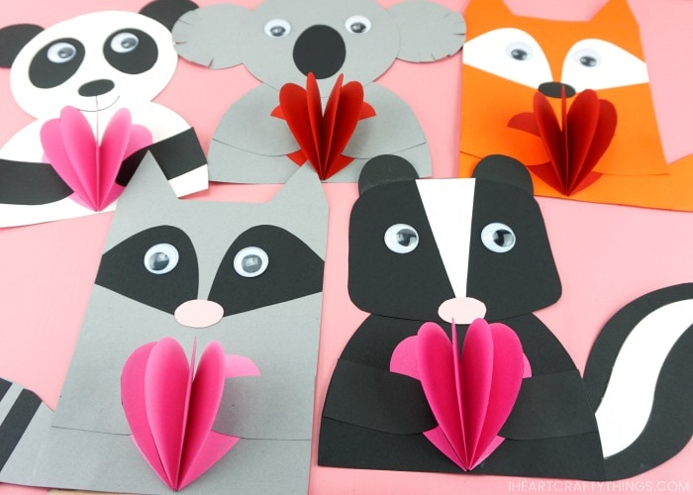
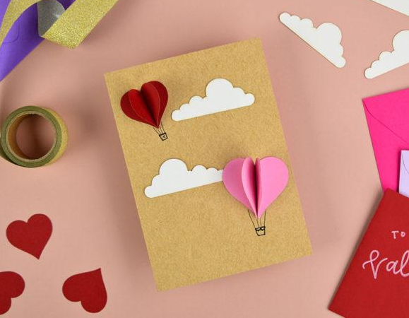
❤ Valentine’s Card Contest ❤

Slide 5
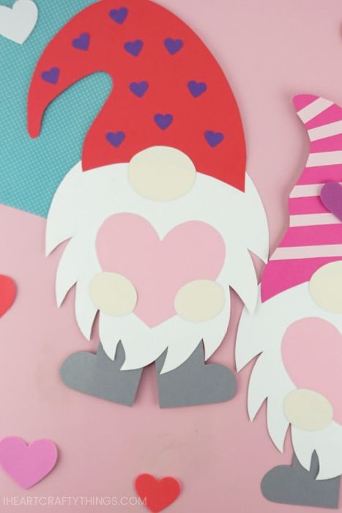
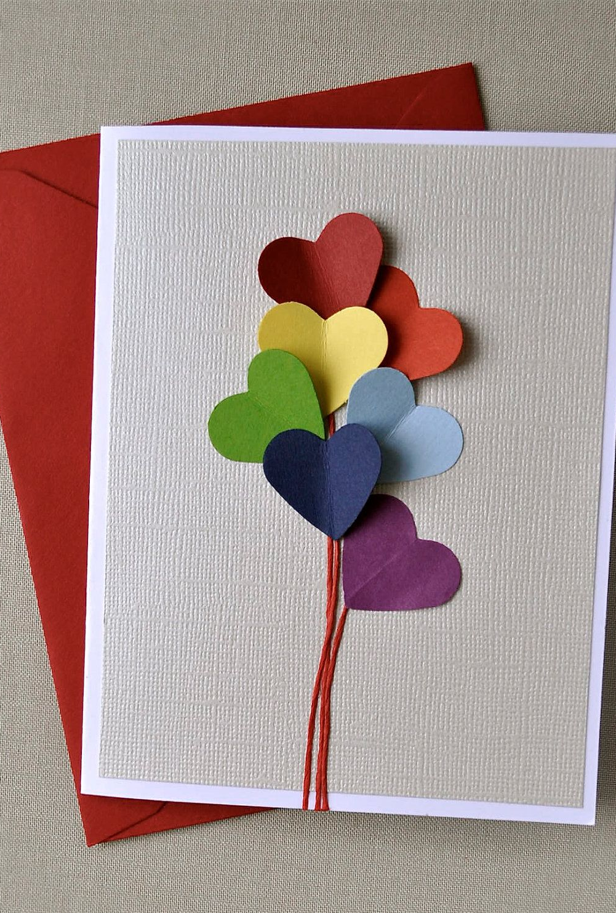
Submit your craft to s.weatherson@muskokawoods.com

Slide 6
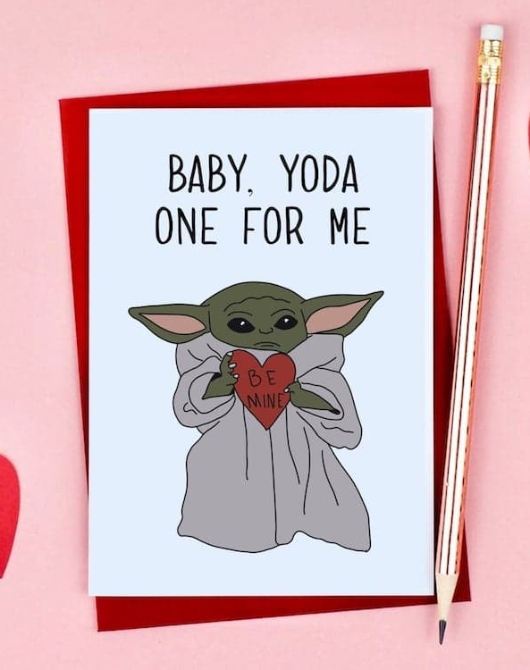
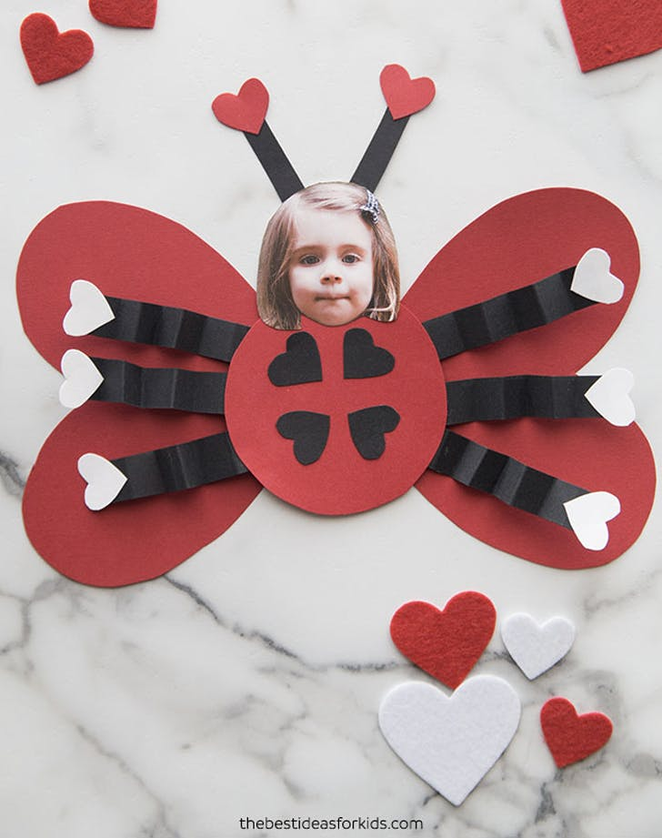
Winners will be announced on February 16th!

